Slide 1
Compact Implementation of CHAM Block Cipher on Low-End Microcontrollers
Hyeokdong Kwon, Hyunji Kim, Seung Ju Choi, Kyoungbae Jang, Jaehoon Park, Hyunjun Kim, and Hwajeong Seo
korlethean@gmail.com
Hansung University
Notes:
Hello everyone this is Hyeokdong Kwon from Hansung University.
This time we talk about Compat implementation of CHAM Block cipher on Low-end microcontrollers

Slide 2
Overview
CHAM Block Cipher
Proposed Implementation
Evaluation
Conclusion
Notes:
The contents are following in this order

Slide 3

Overview
Notes:
Nowadays the Internet of Things, in short IoT becomes feasible services, and embedded processors are developed
To provide high quality services, IoT applications need to encrypt packets before transmission.
However, normally the encryption is expensive for IoT devices, which has limited computation, energy, and storage.

Slide 4



Overview
Lightweight Block Cipher
Less computing power
Little memory usage
Fast execution time
Notes:
So Lightweight Block Cipher have been developed to support secure IoT environments.
Lightweight Block Cipher needs less computing power, requires little storage and guaranteed fast execution time.

Slide 5
CHAM Block Cipher
[ICISC’17]: CHAM proposed from NSR(National Security Research)
[ICISC’19]: Revised CHAM proposed
For convenience, revised CHAM is referred to as CHAM
Cipher | n | k | rk | r | r(old)
CHAM-64/128 | 64 | 128 | 16 | 88 | 80
CHAM-128/128 | 128 | 128 | 32 | 112 | 80
CHAM-128/256 | 128 | 256 | 32 | 120 | 96
Notes:
The CHAM Block Cipher is one of lightweight block cipher, which presented at ICISC'17.
and it's revised version is proposed at ICISC'19.
The difference between the two versions is number of rounds.
We targeted revised version, but for convenience we called CHAM, instead of revised CHAM.

Slide 6
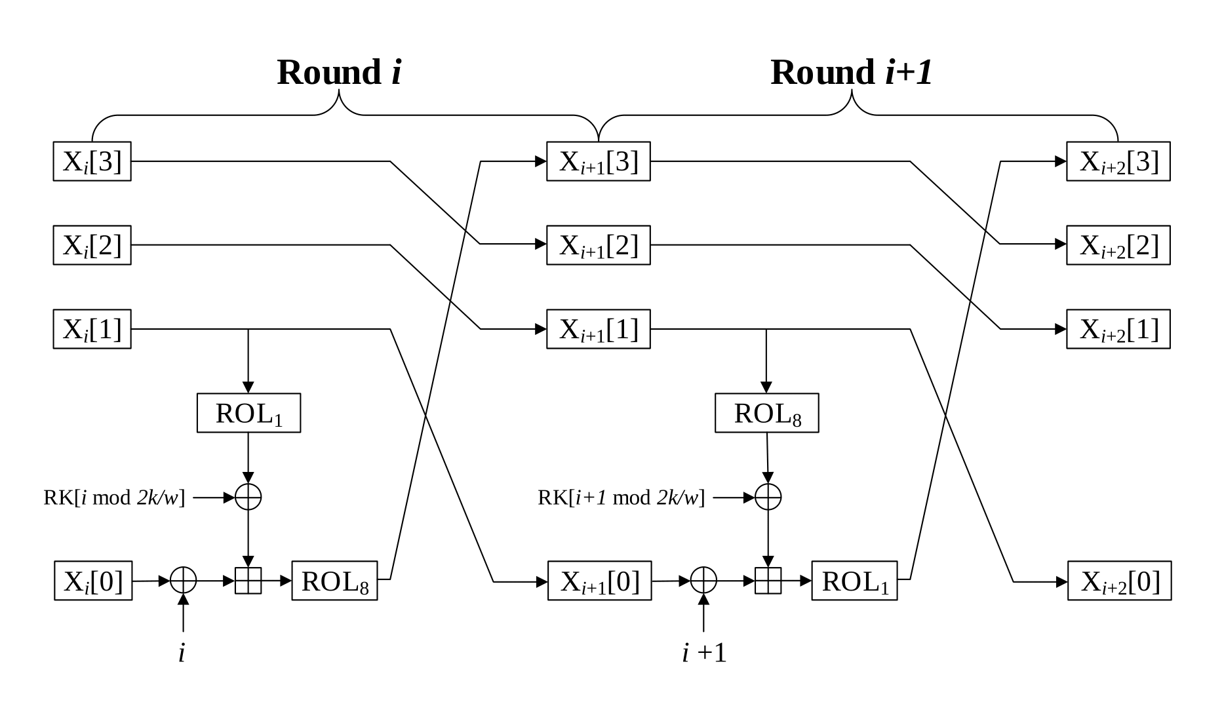
CHAM Block Cipher
4-branch Feistel architecture
ARX based
Notes:
This figure shows round structure of CHAM block cipher.
As we can see, CHAM applied 4-branch Feistel structure, and ARX based block cipher.

Slide 7
Proposed Implementation
The optimized CHAM-CTR mode encryption
On 8-bit AVR microcontrollers
2 kinds of implementations
Pre-computation model
Parallel implementation
Notes:
We propose, the optimized CHAM-CTR mode encryption, and we targeted 8-bit AVR microcontrollers.
There are 2 kinds of implementations, the first is pre-computation model, and the other is parallel implementation.

Slide 8
Proposed Implementation: Pre-computation
The input values of CTR mode of operation
Nonce: Fixed value, 3/4 of total length
Counter: Variable, 1/4 of total length
Nonce
Counter
Notes:
First we show the CTR mode optimization.
The CTR mode using special input values that include Nonce and Counter,
and this value replaces the plaintext, so CTR mode works like a stream cipher.
The Nonce is Fixed value and Counter is Variable.

Slide 9
Proposed Implementation: Pre-computation
The counter value is indicates number of block
Each blocks has identical Nonce value
Calculation result of Nonce part can be pre-computation
Nonce
Counter
1st block
01
23
45
67
89
ab
cd
ef
fe
dc
ba
98
00
00
00
00
2nd block
01
23
45
67
89
ab
cd
ef
fe
dc
ba
98
00
00
00
01
3rd block
01
23
45
67
89
ab
cd
ef
fe
dc
ba
98
00
00
00
02
…
10th block
01
23
45
67
89
ab
cd
ef
fe
dc
ba
98
00
00
00
09
Notes:
At this point, counter is indicates number of block, so each blocks has equal input value, except counter value part.
This Figure shows CTR mode inputs, as we can see all of blocks has same Nonce value, but counter value is different.
Here we can see that there is can pre-compute the result of Nonce part during Round 0 to Round 7.
Then let's look at the structure of each round

Slide 10
Proposed Implementation: Pre-computation
Round 0
Input values
X₀[0]: Counter
X₀[1]: Nonce
Calculate with Nonce, RK part can be pre-computation
These values are fixed
X₀[3]
X₁[3]
X₀[2]
X₁[2]
X₀[1]
X₁[1]
ROL₁
RK[0 mod 2k/w]
X₀[0]
X₁[0]
ROL₈
0
Counter value flow
Notes:
In Round 0, there are one of counter and one of nonce are input.
This red line shows the counter value flow.
We already know that, the result of calculation using Nonce value can be pre-computation.
Thus this parts insturctions are skipped, just load the result value from look-up table.

Slide 11
Proposed Implementation: Pre-computation
Round 1
Input values
X₁[0]: Nonce
X₁[1]: Nonce
Whole instructions are can be skipped
X₁[3]
X₂[3]
X₁[2]
X₂[2]
X₁[1]
X₂[1]
ROL₈
RK[1 mod 2k/w]
X₁[0]
X₂[0]
ROL₁
1
Counter value flow
Notes:
In Round 1, the all of input values are Nonce, so whole instructionos are skipped.

Slide 12
Proposed Implementation: Pre-computation
Round 2
Input values
X₂[0]: Nonce
X₂[1]: Nonce
Same as Round 1
X₂[3]
X₃[3]
X₂[2]
X₃[2]
X₂[1]
X₃[1]
ROL₁
RK[2 mod 2k/w]
X₂[0]
X₃[0]
ROL₈
2
Counter value flow
Notes:
This is the same for Round 2.

Slide 13
Proposed Implementation: Pre-computation
Round 3
Input values
X₃[0]: Nonce
X₃[1]: Counter
X₃[0] ^ (Round Counter) part skip
One more block affected by counter
X₃[3]
X₄[3]
X₃[2]
X₄[2]
X₃[1]
X₄[1]
ROL₈
RK[3 mod 2k/w]
X₃[0]
X₄[0]
ROL₁
3
Counter value flow
Notes:
And in Round 3, there is a slightly different part here.
We can see the XORed with Nonce and Round Counter, and these are fixed value so pre-computation is possible.
However, after Plus operation, it affected by counter value.
Therefore after Round 3, there is one more block affected by counter.

Slide 14
Proposed Implementation: Pre-computation
Round 4
Input values
X₄[0]: Counter
X₄[1]: Nonce
Same as Round 0
X₄[3]
X₅[3]
X₄[2]
X₅[2]
X₄[1]
X₅[1]
ROL₁
RK[4 mod 2k/w]
X₄[0]
X₅[0]
ROL₈
4
Counter value flow
Notes:
Round 4 is same Round 0.

Slide 15
Proposed Implementation: Pre-computation
Round 5
Input values
X₅[0]: Nonce
X₅[1]: Nonce
All of instructions are can be skipped
Same as Round 1, 2
X₅[3]
X₆[3]
X₅[2]
X₆[2]
X₅[1]
X₆[1]
ROL₈
RK[5 mod 2k/w]
X₅[0]
X₆[0]
ROL₁
5
Counter value flow
Notes:
Round 5 is also identical to Round 1, 2

Slide 16
Proposed Implementation: Pre-computation
Round 6
Input values
X₆[0]: Nonce
X₆[1]: Counter
XOR with Round Counter part can be pre-computation
One more block affected by counter
X₆[3]
X₇[3]
X₆[2]
X₇[2]
X₆[1]
X₇[1]
ROL₁
RK[6 mod 2k/w]
X₆[0]
X₇[0]
ROL₈
6
Counter value flow
Notes:
Round 6 XOR part can be pre-computation, and one more block affected by counter.

Slide 17
Proposed Implementation: Pre-computation
Round 7
Input values
X₇[0]: Counter
X₇[1]: Counter
Whole operations are must be implemented
X₇[3]
X₈[3]
X₇[2]
X₈[2]
X₇[1]
X₈[1]
ROL₈
RK[7 mod 2k/w]
X₇[0]
X₈[0]
ROL₁
7
Counter value flow
Notes:
At last, Round 7, all of inputs are affcted by counter, so whole operations are must be implemented.

Slide 18
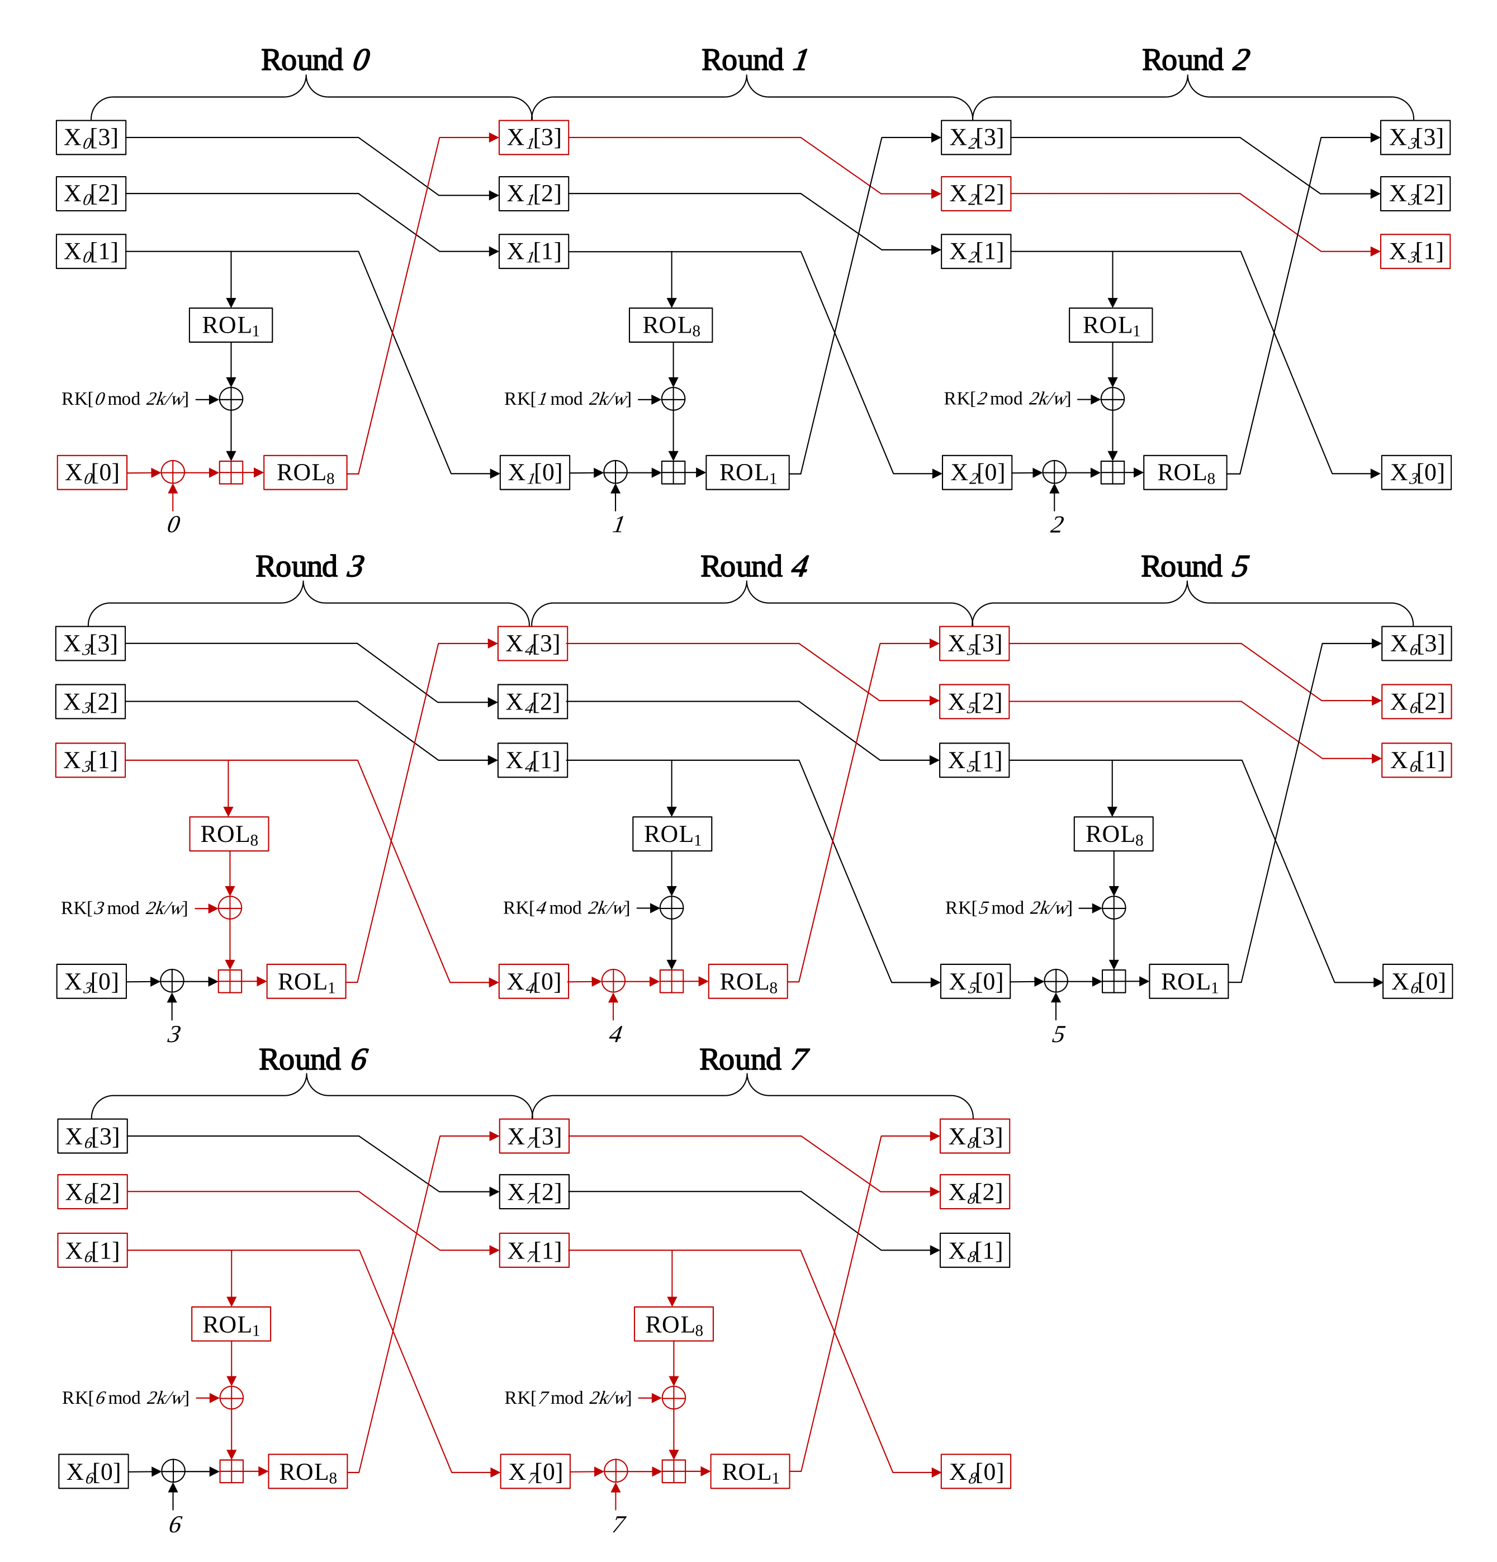
Proposed Implementation: Pre-computation
Original CHAM structure
Red line: Counter value flow
Pre-computation part can be skipped
Notes:
To sum it up, the original CHAM structure is following this figure.
As we can see the counter value flow, and these part cannot pre-computation.

Slide 19
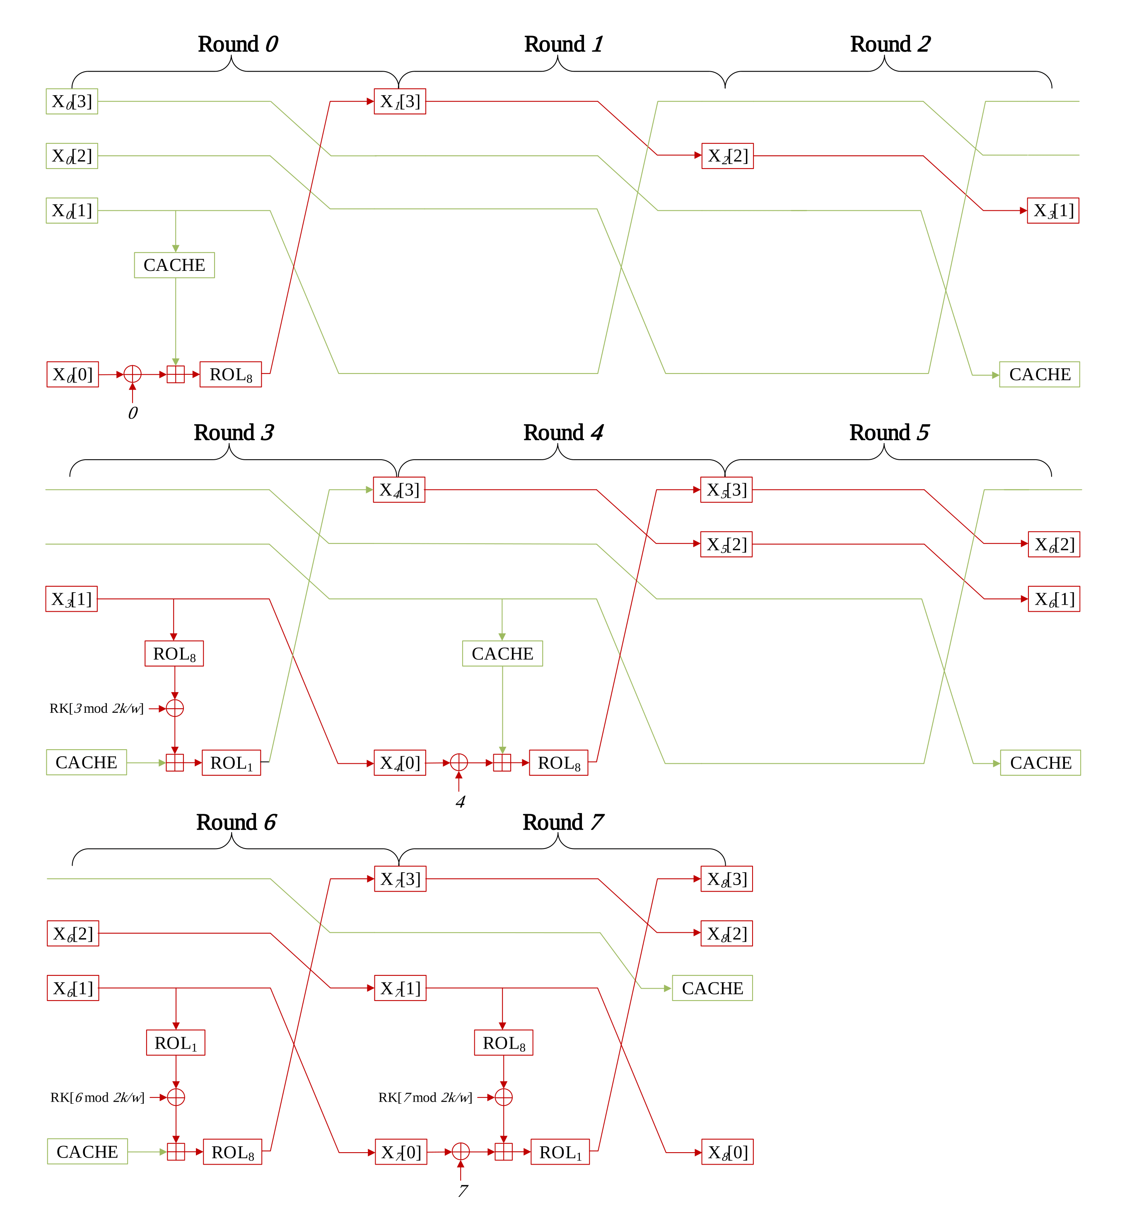
Proposed Implementation: Pre-computation
Optimized CHAM structure
Some instructions are removed
5 ROL(1-bit)
3 ROL(word-wise)
10 XOR
3 ADD
Result is load from look-up table
Notes:
and this is proposed CHAM round structure.
In this structure, these instructions are skipped, so it can be achieved higher performance then previous works.

Slide 20
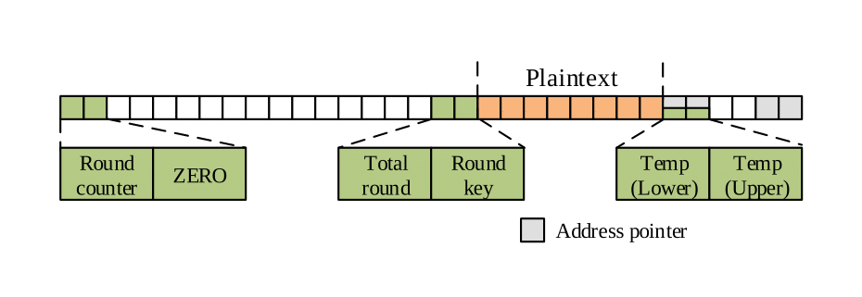
Proposed Implementation: Parallel implementation
CHAM-64/128 has unused registers
Utilize these registers for Parallel implementation
Notes:
The second is parallel implementation.
In case of CHAM-64/128 has many unused registers.
If utilize these registers, it can be implement parallel implementation.
Parallel implementation can operates multiple encryption. It makes improve performance.
For parallel implementation, we considered register allocation.

Slide 21
Proposed Implementation: Parallel implementation
Value | Description
Total round variable | Using CPI instruction, total round value is not maintained in the register
Plaintext block | Temporarily stored in STACK memory
Address pointer | Stored in STACK, since pointer is not used throughout computations
Round key | By accessing byte by byte, only single register is utilized
Round counter | Saved in STACK and only loaded when performing XOR operation
ZERO | In case of 3-parallel, some registers are temporarily initialized
Notes:
This table summarizes what values are allocated for register.
The total round variable, such as 88, 112, and 120, we using CPI instruction instead using register.
CPI instructions can be compared immediately without register, so round variable isn't allocated in the register.
And each round, the input values are only X[0] and X[1]. So some of plaintext block can be stored in STACK memory.
Address pointer is used for loading round key and saving encryption result.
At this point since the encryption result is stored last, so pointer can be placed on the STACK during computations.
Next, round key is 16-bit but by accessing byte by byte, only one register is needed.
and round counter is only used for XOR operation, to save in STACK and loaded when it required.
Last is ZERO register. originally R1 is ZERO register, but in case of 3-parallel there is lack of register was happened.
So some registers are temporarily initialized as ZERO.

Slide 22
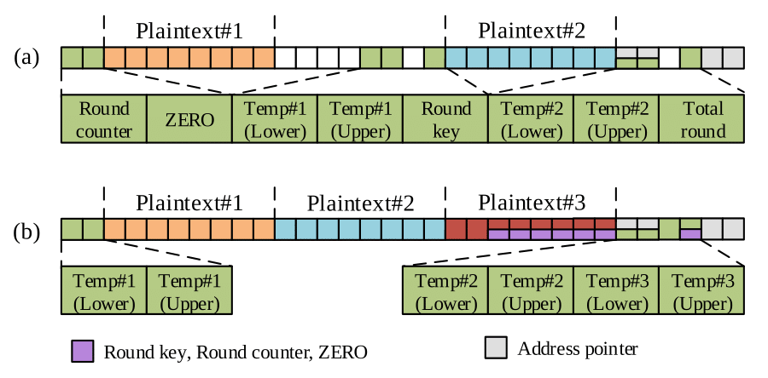
Proposed Implementation: Parallel implementation
(a): 2-parallel implementation
(b): 3-parallel implementation
Notes:
This figure shows our register allocation plan.
There are some unsed register for 2-parallel implementation.
On the other hand, 3-parallel implemenation using whole registers, and some registers are used for multiple perpose.

Slide 23
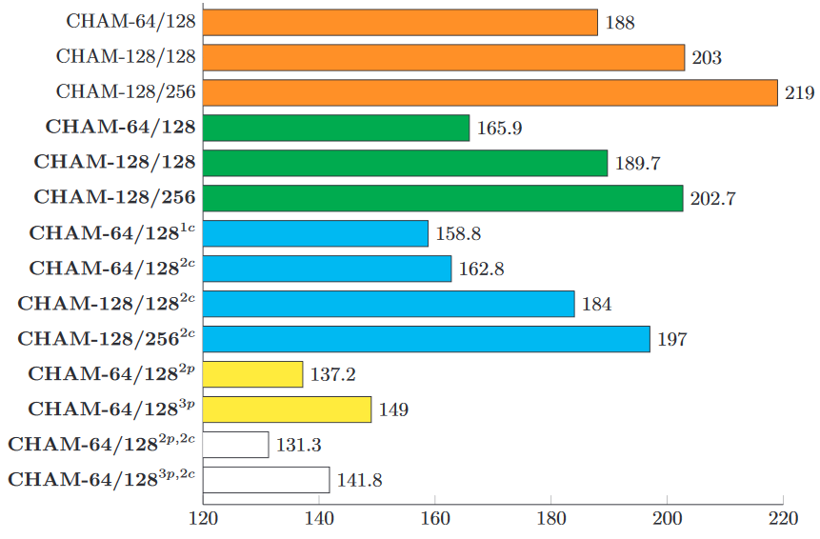
Evaluation
ICISC’19 implementation
Basic optimal implementation
Optimized CTR mode implementation
Parallel implementation
Unit: clock cycles per byte
Notes:
Now evaluated our implementation.
There are 4-kinds of implementation. The first is ICISC'19 implementation, which is original.
And second is our basic version of optimal implementation, and third is proposd optimized CTR mode implementation.
Last one is parallel implementation. We compare with our basic version and proposed implementation.

Slide 24
Evaluation
The implementation improved performance 4.2%, 3.0%, 2.8%
2-parallel: 137.2 3-parallel: 149.0
Unit: clock cycles per byte
Notes:
Proposed implementation skipped about 21 operations and it replaced 5 load instructions.
The implemenataions improved performance 4.2%, 3.0%, and 2.8% for CHAM-64/128, CHAM-128/128, and CHAM-128/256
for respectively.
Also parallel implementations achived greater performance than the others,
2-parallel implementation operate 137.2 clock cycles per byte, and 3-parallel implementation takes 149 clock cyles per byte.

Slide 25
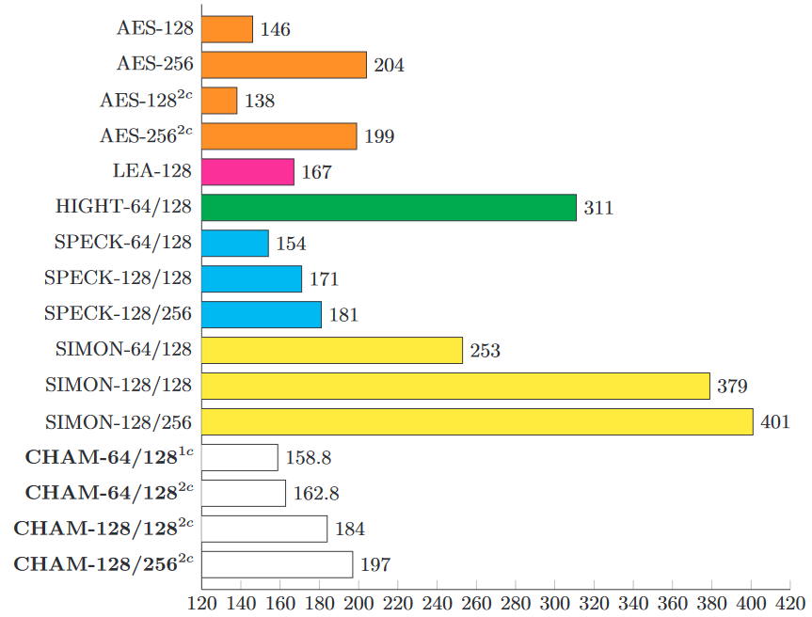
Evaluation
Compared with other block ciphers
AES achieved the highest performance
SPN based
Proposed CHAM is second winner
Among ARX based
Notes:
And we also compared with other block ciphers.
The SPN based AES achieved the highest performance, because it designed to fit into 8-bit word architecture and.
Among ARX based implementations, SPECK shows fastest performance, and second winner is proposed implementations.

Slide 26
Conclusion
In this paper optimized CHAM-CTR proposed
Pre-computation model: 5 ROL(1-bit), 3 ROL(word-wise), 10 XOR, 3 ADD skipped
Parallel implementation: 2-Parallel, 3-Parallel CHAM-64/128
Proposed implementation achieved fast execution timing
It is practical IoT applications
Future works
Applying proposed techniques to other ARX based block ciphers
i.e. SPECK, SIMON
Variable key scenario implementation
Other microcontrollers will be investigated
Notes:
Conclude this presentation.
We propose the optimized CHAM-CTR mode encryption.
It used pre-computation, so some of instructions can be skipped, and get result from look-up table.
the second is parallel implementations for CHAM-64/128, it can be encrypt multiple plaintext blocks.
Proposed implementations achieved fast excution timig, so it is practical for IoT applications.
Our future works are applying our proposed techniques to other ARX based block ciphers.
and this implementation is under fixed-key scenario, so we also implement variable-key scenario implementation.
last, we targeted 8-bit AVR microcontrollers in this paper, next we target to other microcontrollers
such as 16-bit MSP and 32-bit ARM.
This is end of presentation. Thank you for listening.

